Slide 1
What is container?
It is instance of an image
It is image in running state
It is ultra thin Virtual machine (net, mem, cpu, device)

Slide 2
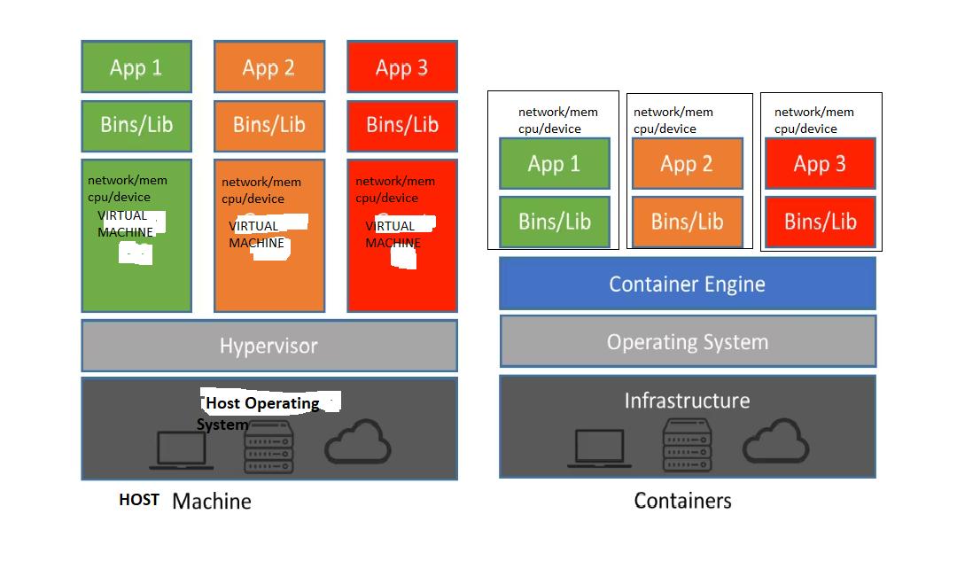
Why are we saying container is the thin VM?

Slide 3
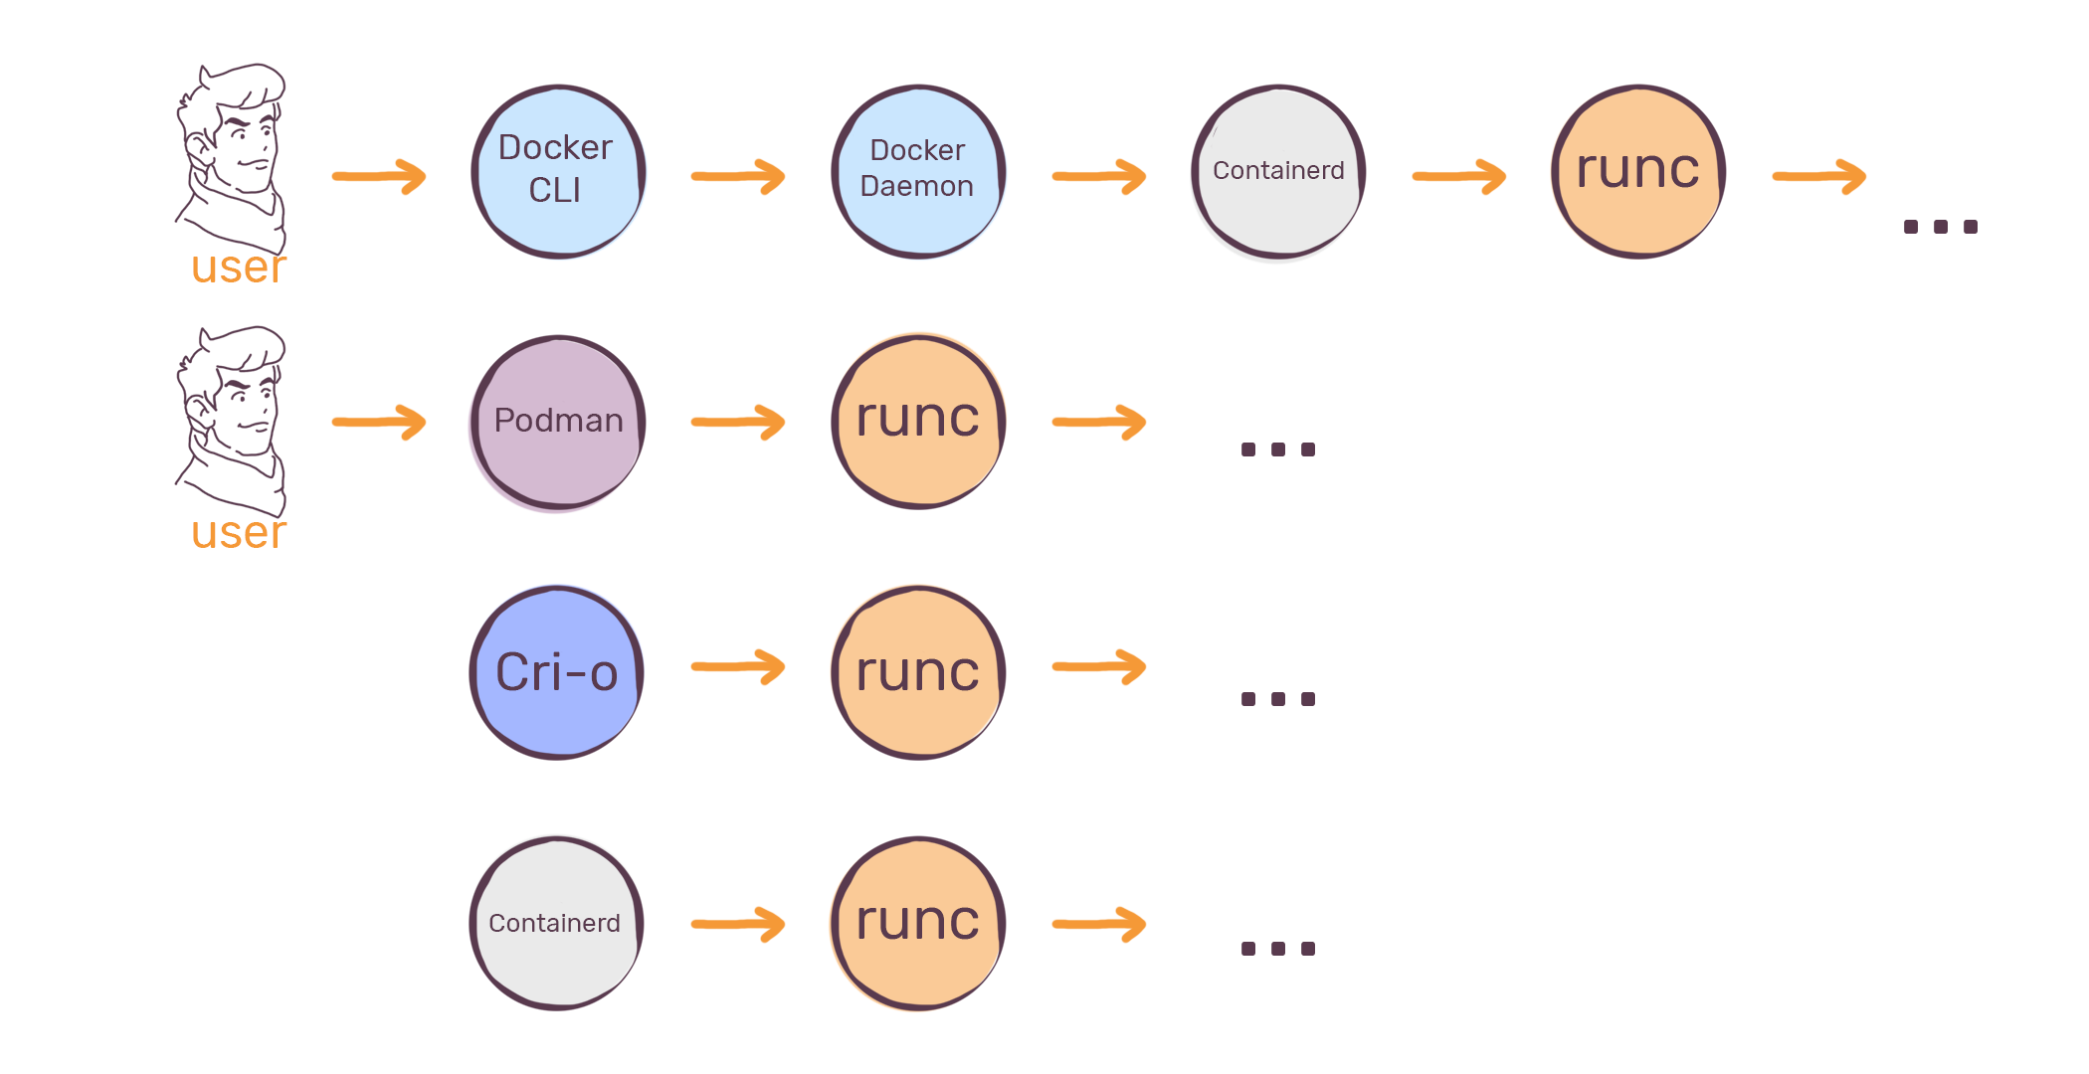
What are different Container engines are there in industry ?
container engine is develop, manage, and run OCI Containers on your Linux System.

Slide 4
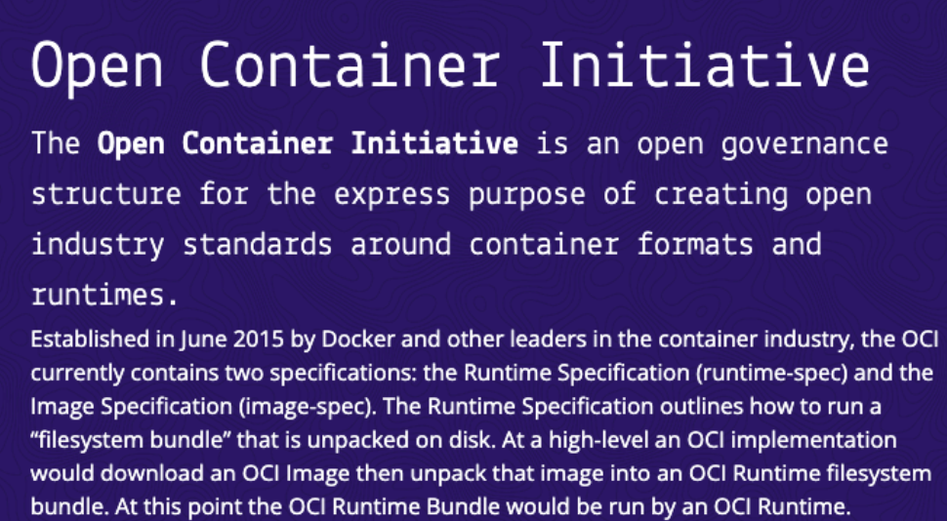
Can we run container image on podman which built on docker?

Slide 5
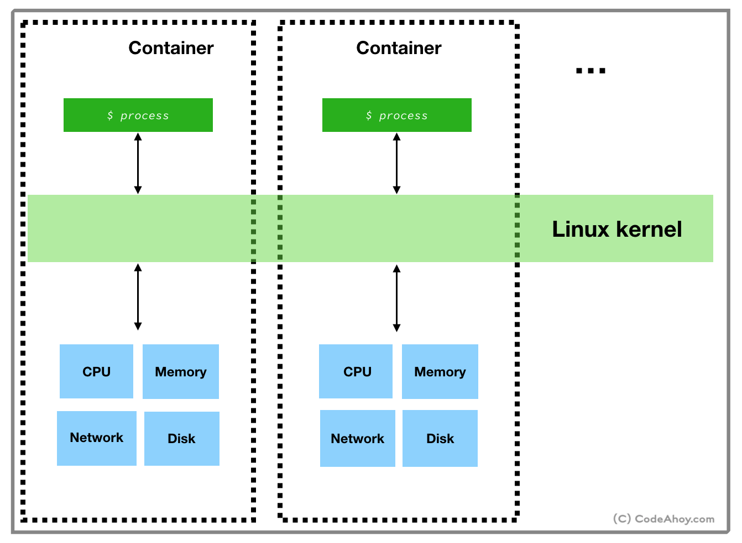
What runc does inside?

Slide 6
Running a Container
How we can Inspect a it?(inspect, attach)
How can we monitor its stats?(ps,top)
How can we check logs of running application inside its?(logs)
Install and run applications in it.(exec)
How can we create image from the running docker ? (commit)

Slide 7
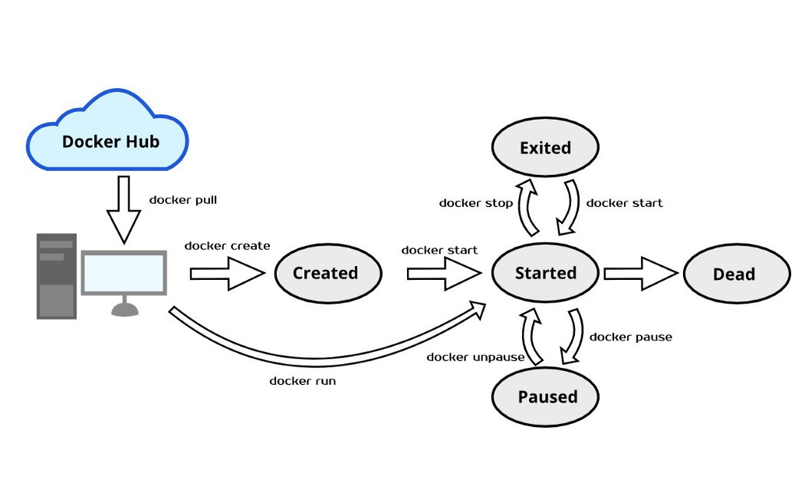
Container states

Slide 8
CMD vs ENTRYPOINT

